Slide 1
Rules for evaluation of expression
First parenthesized sub expression left to right are evaluated.
If parenthesis are nested, the evaluation begins with the innermost subexpression.
The precedence rule is applied in determining the order of application of operators in evaluating sub expressions.
The associability rule is applied when two or more operators of the same precedence level appear in the sub expression.
Arithmetic expressions are evaluated from left to right using the rules of precedence.
When Parenthesis are used, the expressions within parentheses assume highest priority.
Note: Precedence of operators decreases from top to bottom in the given table.

Slide 2
EXPRESSION EVALUATION
In C programming language, expression is evaluated based on the operator precedence and associativity.
simple example expression… 10 + 4 * 3 / 2
In the above expression there are three operators +, * and /. Among these three operators, both multiplication and division have same higher precedence and addition has lower precedence.
So, according to the operator precedence both multiplication and division are evaluated first and then addition is evaluated.
As multiplication and division have same precedence they are evaluated based on the associativity.
Here, the associativity of multiplication and division is left to right.
So, multiplication is performed first, then division and finally addition.
So, the above expression is evaluated in the order of * / and +. It is evaluated as follows…
4 * 3 ====> 12
12 / 2 ===> 6
10 + 6 ===> 16
The expression is evaluated to 16.

Slide 3
TYPE CONVERSION
A type cast is basically a conversion from one type to another.
There are two types of type conversion :
IMPLICIT TYPE CONVERSION(automatic type conversion)
EXPLICIT TYPE CONVERSION(type casting)

Slide 4
IMPLICIT TYPE CONVERSION
Also known as ‘automatic type conversion’.
Done by the compiler on its own, without any external trigger from the user.
Generally takes place when in an expression more than one data type is present. In such condition type conversion (type promotion) takes place to avoid lose of data.
All the data types of the variables are upgraded to the data type of the variable with largest data type.
The following rules have to be followed while converting the expression from one type to another to avoid the loss of information:
All integer types to be converted to float.
All float types to be converted to double.
All character types to be converted to integer.
It is possible for implicit conversions to lose information, signs can be lost (when signed is implicitly converted to unsigned), and overflow can occur (when long long is implicitly converted to float).

Slide 5
Example of Type Implicit Conversion:
#include<stdio.h>
int main()
{ int x = 10; // integer x
char y = 'a'; // character c
// y implicitly converted to int. ASCII
// value of 'a' is 97
x = x + y;
// x is implicitly converted to float
float z = x + 1.0;
printf("x = %d, z = %f", x, z);
return 0;
}
Output: x = 107, z = 108.000000

Slide 6
EXPLICIT TYPE CONVERSION
This process is also called type casting and it is user defined. Here the user can type cast the result to make it of a particular data type.
The syntax in C: ( type ) expression
Here, type indicated the data type to which the final result is converted.

Slide 7
Example of Explicit Type Casting Conversion:
#include<stdio.h>
int main()
{ double x = 1.2;
// Explicit conversion from double to int
int sum = (int)x + 1;
printf("sum = %d", sum);
return 0;
}
Output: sum = 2

Slide 8
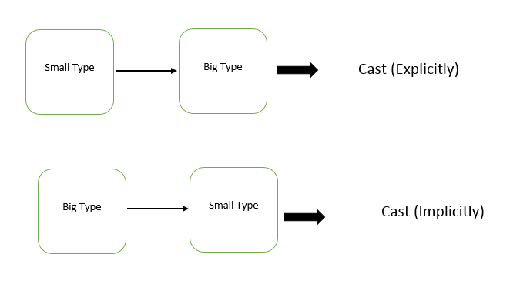
Advantages of Type Conversion
This is done to take advantage of certain features of type hierarchies or type representations.
It helps us to compute expressions containing variables of different data types.

Slide 9
Inbuilt Typecast Functions In C:
There are many inbuilt type casting functions available in C language which performs data type conversion from one type to another.
Typecast function Description
atof( ) converts string to float
atoi( ) converts string to int
atol( ) converts string to long
itoa( ) converts int to string
ltoa( ) converts long to string

